Slide 1
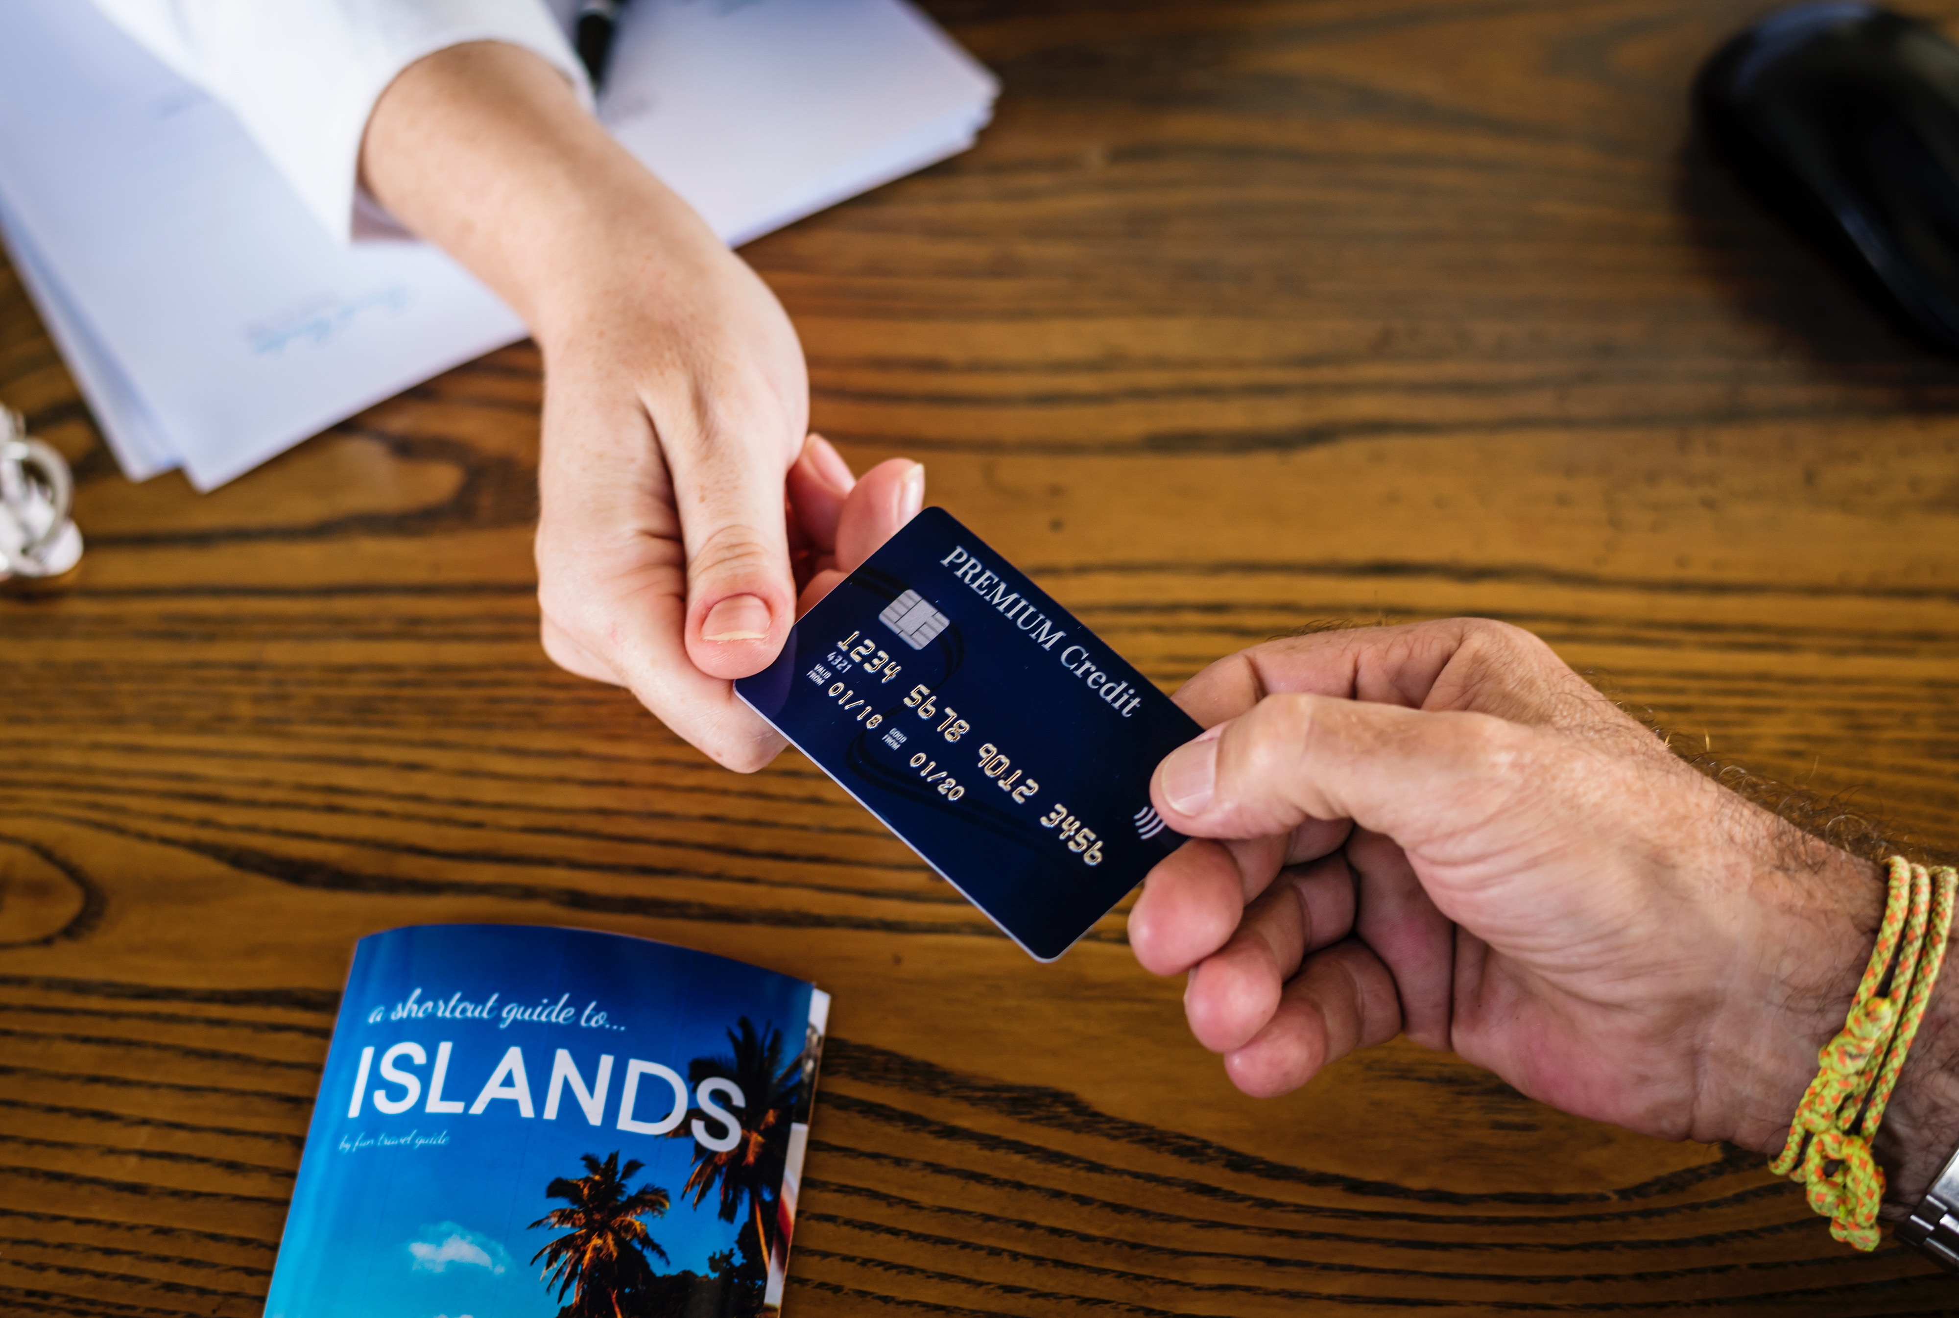
Group 2 Credit Card Approval Prediction
Cody Gardner
Bradley Barker
David Owens
Marie Prosper

Slide 2
Goal
To predict whether the customer will default on their credit card payment next month.

Slide 3
Technologies
Python (Jupyter Notebook, Pandas)
Flask
SQL/ Postgres DB
JavaScript Libraries (D3, Plotly, Leaflet)
HTML/ CSS (Bootstrap)
Csv
Machine Learning
Tableau

Slide 4
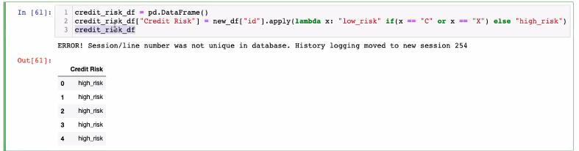
Credit Risk

